Slide 1
AR ARCADE
Project group 5
Guided by: Dr. Aznam Yacoub

Slide 2
Customer : Mr. Husain Kagalwala
Project Director : Mr. Krishna Sabbella
Team Members:
Jay Hemalkumar Shah (shah4v)
Jay Pareshbhai Shah (shah6w)
Prabhangad Singh (singh2m1)
Mansi Miteshkumar Shah (shah3w)
Dhruvi Jyotindra Patel (patel2m4)
Sandhya Bharatbhai Ramoliya (ramoliys)
Meha Dharmesh Naik (naik71)
Dimple Harshadbhai Chandrani (chandr23)

Slide 3
OUTLINE
Introduction:
Need
What we offer
Business related problems
2. Solution:
Technologies
Game Features
3. Methodology:
Lifecycle used
Pipeline
Architecture
Quality management
Risk Management
4. Design
5. Testing
6. Demo
7. Conclusion
8. Future scope

Slide 4
INTRODUCTION
1

Slide 5
NEED OF THE CUSTOMER
The need of the customer is to be offered a game which is based on omniverses or metaverses.
The game should be innovative enough to keep the users entertained.
And, it should include real time surroundings

Slide 6
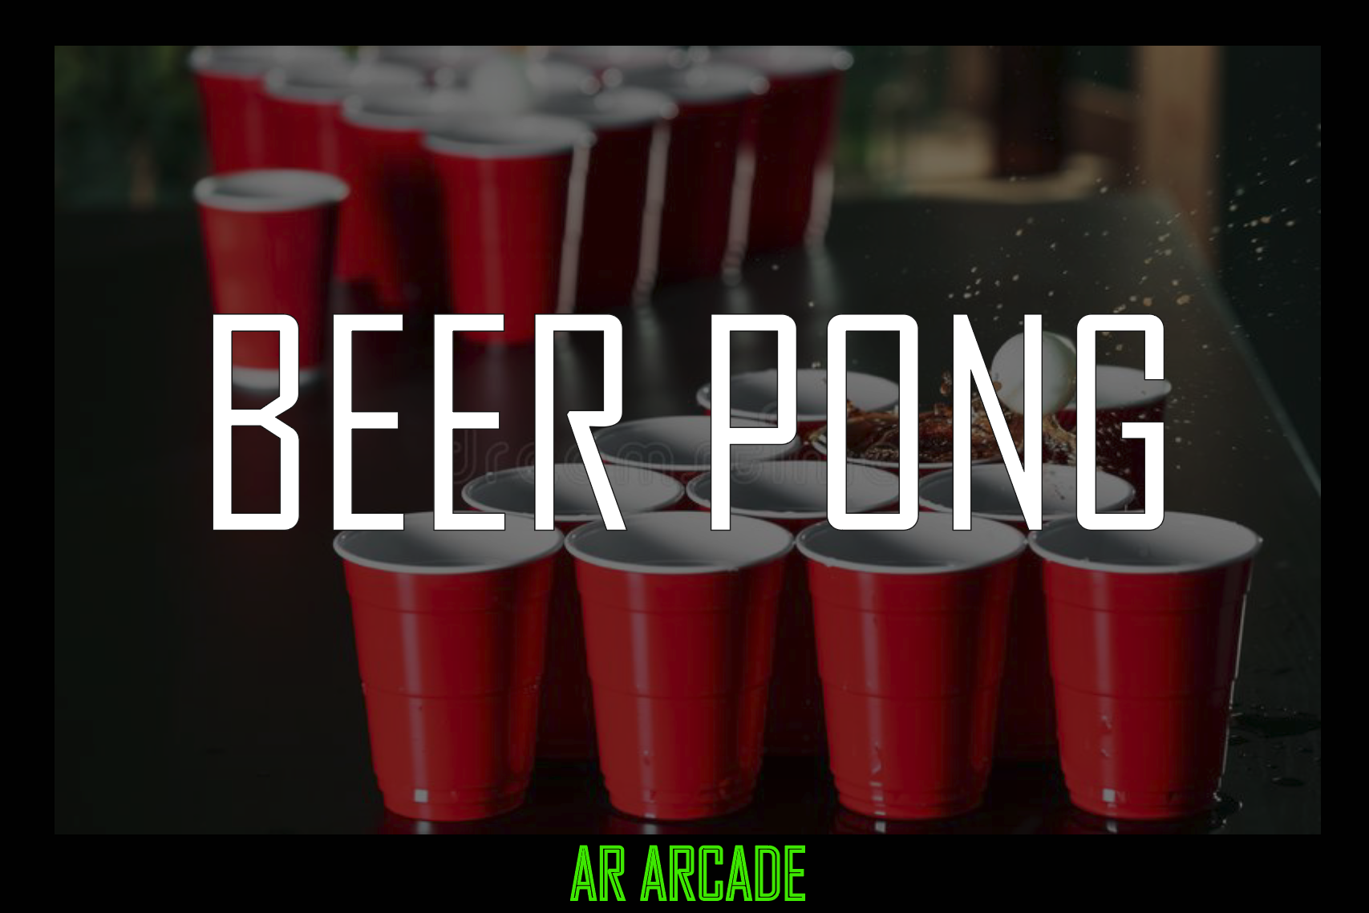
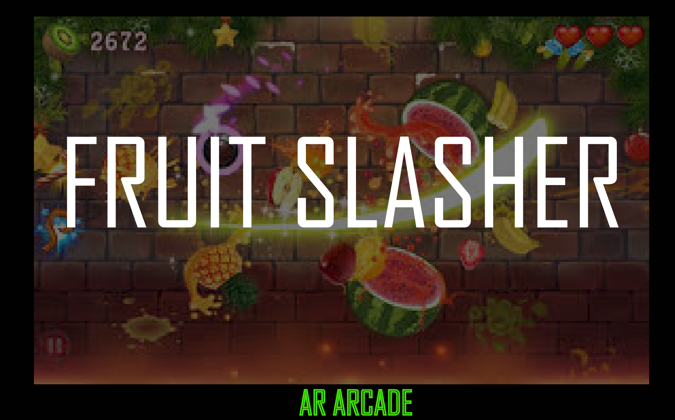
WHAT WE OFFER
Our objective is to bring interesting games to one application and add augmented reality features to make them stand out.
We are offering 2 single-player mobile games using AR.
1. Beer Pong
2. Fruit Slasher

Slide 7
MARKET RESEARCH
The demand for AR mobile games:
Nowadays, mobile is the most common device, which makes AR mobile games one of the best choices that provide real world experience to the users. In this way, without spending a lot of money, the users can get an unforgettable experience.
The ability to combine digital information and real-time in one game will be a game-changer for game developers.

Slide 8
Present gaming market:
The rising usage of gaming has an impact on family bonding, and cultural decorum appears to be gradually being abandoned.
As a result, we chose to fix the problem by utilizing the source of the problem, namely the mobile device.

Slide 9
Market risk:
With technological advancements, our application will need to keep up with the current modifications.
Dealing with storage costs will also be a constant risk in the market.
Revenue strategy:
Advertising and marketing promotions
Premium version

Slide 10
SOLUTION
2

Slide 11





TECHNOLOGIES USED
Android SDK
Visual studio

Slide 12
WHY UNITY?
Unity is a cross-platform application that supports a variety of SDKs for various operating systems.
Unity has AR-Foundations package that making AR games easier!
No paywall! All the core features are free to use.
Better tools for android game development.
Games like pokemon go, Ingress and angry birds were made with unity.

Slide 13
TECHNOLOGIES USED
JIRA is a project management tool that supports a variety of software development methodologies as well as bespoke methodologies for tracking development milestones.
It helped us to create scrum boards that could track our sprints and backlogs, allowing us to complete projects quickly and efficiently.

Slide 14
WHY JIRA?
Appropriate for Agile development
Requirement management
Test case management
Track sprints and the progress
Track bugs

Slide 15
Augmented Reality
Augmented reality (AR) is a technologically augmented version of the real world that is created through the use of digital visual elements, music, or other sensory stimulation.
We're attempting to incorporate this technology into our game in order to produce augmented reality maps, buildings, and data streams that can be projected onto tabletops and viewed collaboratively by built environment professionals

Slide 16
GAME FEATURES
Main features of Beer pong game:
Detection of planes
Placing the cup
Throwing of balls
Scoring
Main features of Fruit Slasher:
Spawn points
Create spawnable prefabs for fruits
Fruit slicing mechanism
Penalty system
Scoring system
Game UI

Slide 17
METHODOLOGY
3

Slide 18
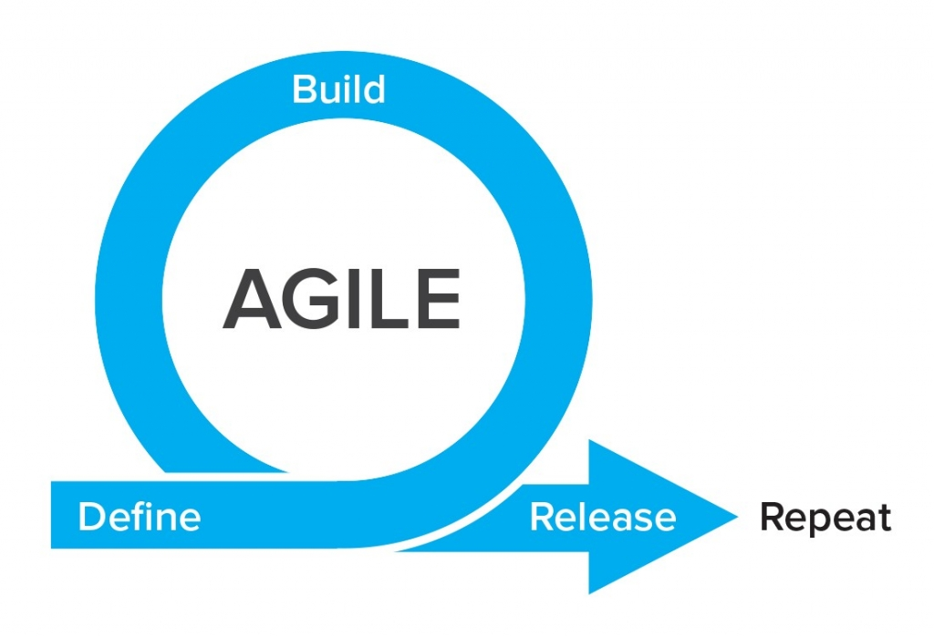
LIFECYCLE USED
The Agile methodology breaks a project down into multiple cycles, each passing through some or all of the SDLC phases.
Scrum is a very popular Agile framework characterized by continuous collaboration, frequent deliveries, and special development cycles called ‘Sprints’
In scrum we emphasize on working software over comprehensive documentation

Slide 19
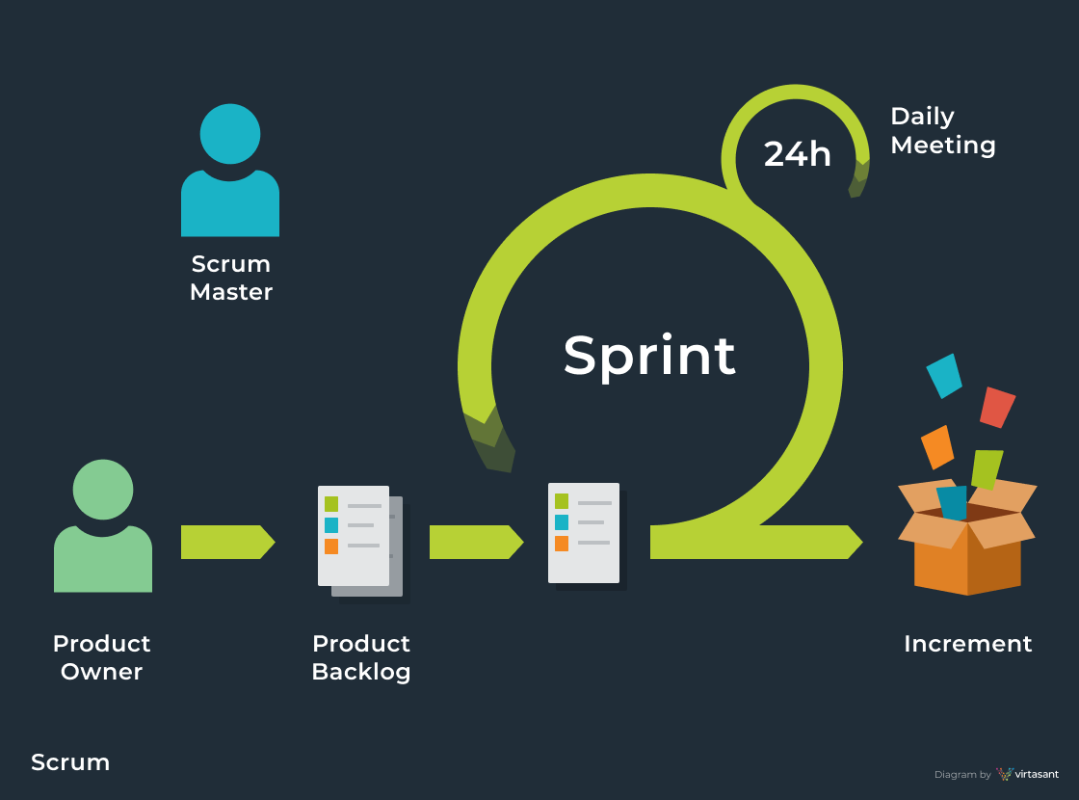
AGILE-SCRUM
His job is to manage and improve processes, help the team stay authentic to Agile values, and focus on maximizing productivity
A prioritized features list, containing short descriptions of all functionality desired in the product

Slide 20
WHY SCRUM?
Early visible progress
Flexible and adaptable process enables pivots or changes mid-project
Early feedback
Early mitigation of high risk

Slide 21
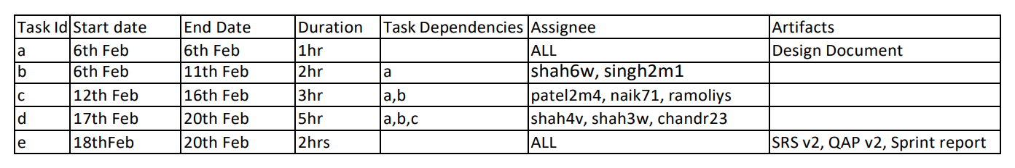
Sprint-1
a. Creating an AR Game in Unity.
b. Identifying planes with Unity AR Foundations.
c. Placing cups on planes for the Beer Pong game.
d. Create throwable balls.

Slide 22
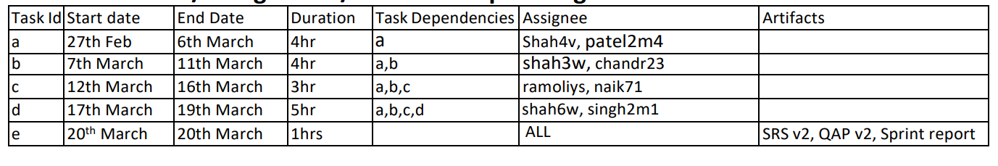
Sprint-2
a. Fix ball spawning, speed, and throwing angle bugs.
b. Create Game UI, which includes score manager and scene manager.
c. Create Main Menu.
d. Create Fruit Spawning Placeholders and fruit prefabs.

Slide 23
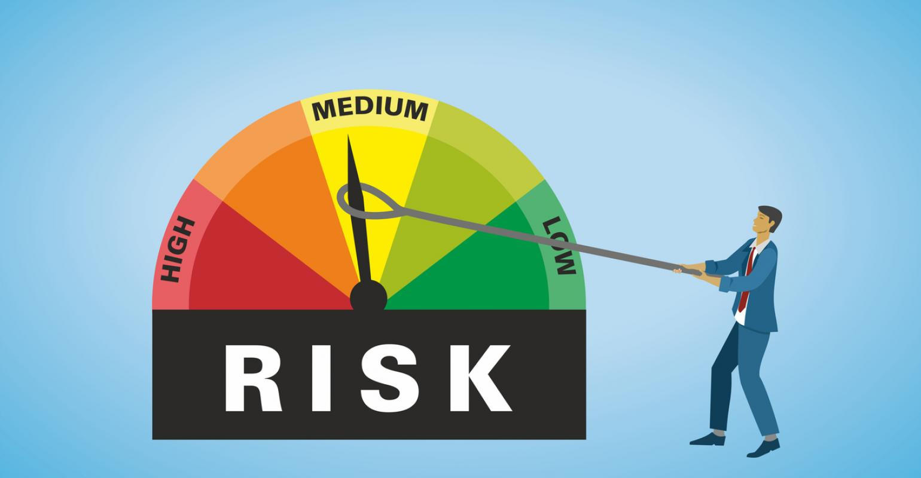
RISK MANAGEMENT
The process of determining the probability of a risk occurring while working on a project is known as risk analysis.
Failure to recognize potential risks can cost a project in terms of time, money, and quality.

Slide 24
RISK ANALYSIS
Poor time management
Unexpected and urgent project scope expansion and lack of resources
Incorrect Budget Estimation
Poor code quality and Technical Risk:
Constant changes in software requirements
lack of professionalism & knowledge

Slide 25
RISK ANALYSIS
Poor Productivity :
Poor project management
Wrong team formation
Lack of communication & leadership
Unpredictable external links
Sudden market changes
Implementation of government rules
Changes in consumer behavior and priorities

Slide 26
RISK MITIGATION
Risks can be managed through :
Proper project structure and development techniques:
More emphasis on prototype and pre production phases of development.
Building low-budget game.
Adoption of agile methodology:
Increased customer satisfaction.
Find solutions for continuous changing needs.
Continuous monitoring of risks and implementation of risk management plan.

Slide 27
QUALITY MANAGEMENT
Scrum meetings
Code quality
Proper naming and indentation in code
Appropriate file structure
Code documentation
Cost estimation
Testing

Slide 28
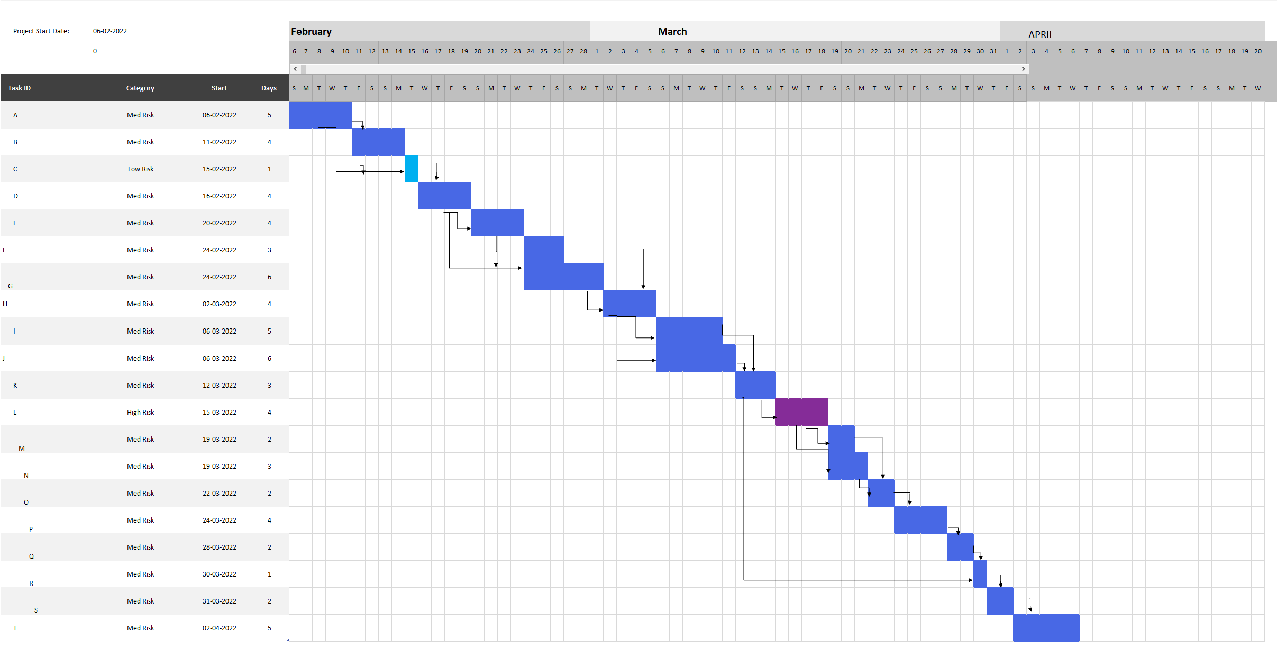
Gantt Chart
Scrum meetings
Code quality
Proper naming and indentation in code
Appropriate file structure
Code documentation
Cost estimation
Testing

Slide 29
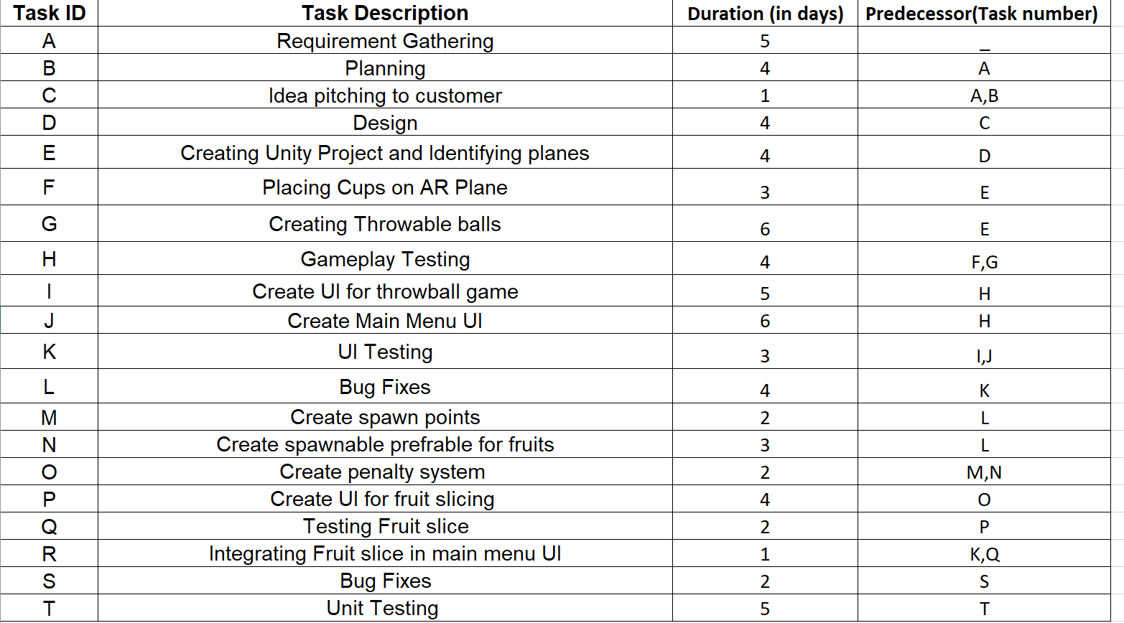
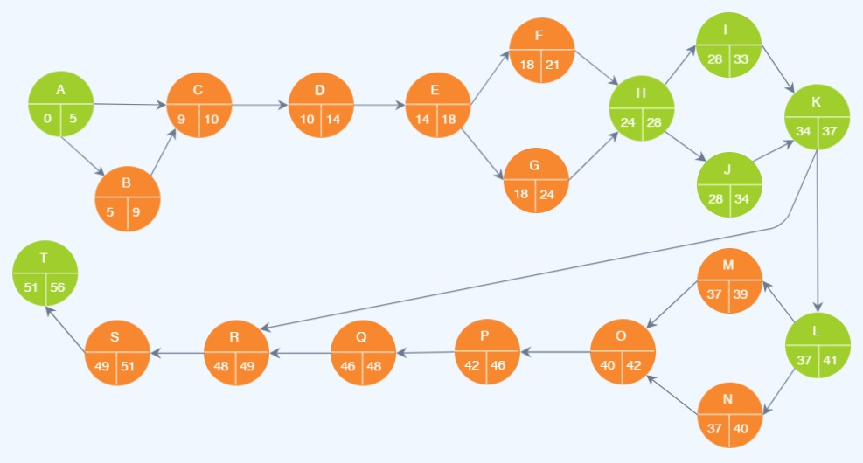
Pert Chart

Slide 30
DESIGN
4

Slide 31
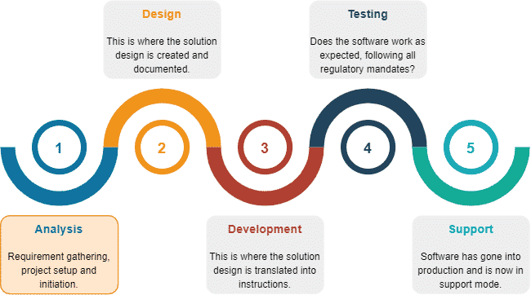
HIGH LEVEL DESIGN
The architecture that would be used to construct a system is described in the high-level design. The architecture diagram depicts the overall system, defining the main components and their interfaces that will be produced for the product.

Slide 32
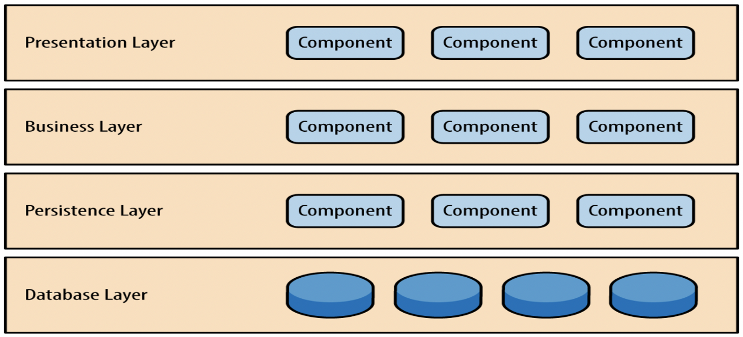
ARCHITECTURE
Layered Architecture:
As the name says, the architecture has components that are horizontally layered on top of each other.
This approach is the most favourable approach to building software and here the team is to be self-independent.
This means that the components are interconnected and are not dependent on each other.
This architecture allows a clean separation of components and also helps gather code in one location

Slide 33
It mainly contains 4 layers they are Presentation Layer, Business Layer, Persistent Layer and Database Layer.
Presentation Layer: It contains everything related to the views and the design of the game
Business Layer: This part contains the business logic.
Persistence Layer: All the object-oriented mapping function is done in the persistence layer.
Database Layer: As the name says, it will contain references to the database, and it will be the location where the data will be stored.
Along with these layers, many other layers can be added to the architecture, like the service layer. After adding layers, it will turn into a hybrid architecture. This architecture is mainly used where the user count is low. There is one catch here the development team should be sure that requirements won’t be more after the game goes live

Slide 34
PROS:
It is easy to implement and also easy to test. The reason why it is easy to test is that there are different layers, and they can be tested separately is simple and easy to implement because naturally, all the applications work in layers.
CONS:
Changes cannot be done easily, because the application is in a single unit. The larger the software is, the more requests will be done throughout the layers and if the application is on a large scale, it may cause performance issues.

Slide 35
TESTING
5

Slide 36
TESTING
The Unity test runner was used to run units on the game
It allows to test on standalone platform
We can also test in both edit and play mode
After every sprint testing was conducted

Slide 37
DEMO

Slide 38
CONCLUSION
By using the Software Engineering methodologies and various technologies, we are able to successfully develop a mobile AR game that fulfils all the customer’s requirements.

Slide 39
FUTURE SCOPE
We will implement reward system, where the user could earn rewards on scoring a certain number of points in the game.
We are planning to expand our AR Arcade by adding more games like Jenga, Racing, Beyblade in the multiplayer section and Plants vs zombies, horde mode, maze in the single player game section.

Slide 40
THANKS!
Any questions?

